Slide 1
Social Community
Apoorva Kumar Channankaiah
Arpit Parikh
Navreet Kaur
Rajat Vij
Xiaobei Yu

Slide 2
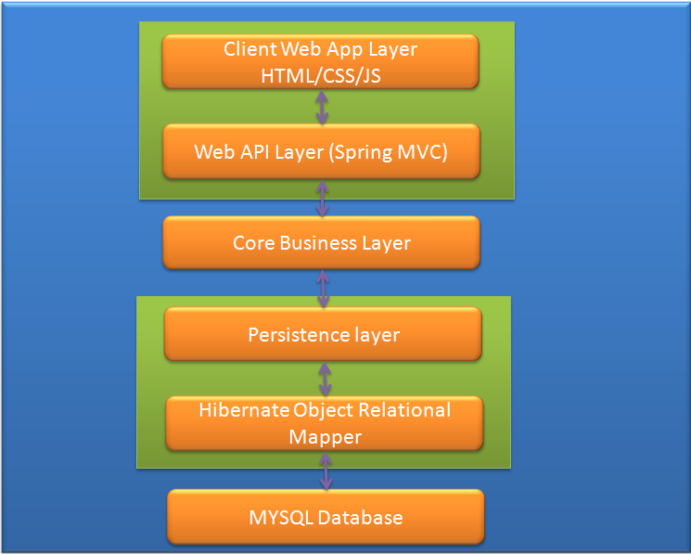
Architecture Of the Application

Slide 3
Architecture Component Details
Data base: Our Application uses MySQL relational database.
We chose relational database over NoSQL and other databases because:
Our application data is very simple and can be stored in tables easily;
SQL query language is well developed and very easy to use with great online support;
All team members are well versed with it
It is secure, inexpensive, scalable, manages memory well, runs on many operating systems.

Slide 4
We used Hibernate Object Relational Mapper to talk to our database. Reasons for choosing Hibernate:
Easy Maintenance.
It is widely used with java so we wanted to learn it.
Highly Portable(Changing of database dialect is easy.)
Free or Cost Effective.
Spring Framework supports integration with Hibernate.

Slide 5
Persistence Layer: We created a java project for persistence layer. All the Dao classes along with domain and constant classes are added in this project. Dao classes are the only classes which make database queries and fetching result.
Core Business Layer: For business logic we created a java project. All the Service are added in this project. Business logic is implemented in Service classes and they call DAO classes for making database queries and fetching result.

Slide 6
Web API Layer and Client Web App Layer : We used Spring Framework for web API layer. We created a java dynamic web project which includes all the controller classes, all the web components like jsp, css, js, images etc and all the configuration files. We used Spring framework to send and accept front end requests. In profile module we also implemented RESTful API i.e. receiving requests from client in json format and sending response from server.

Slide 7
Technologies Used
Why Spring?
Easily available resources and an active community around the Framework.
Extensibility, the fact that Spring or another framework can be built on top and extend to other mini-frameworks.
Provides benefits like Aspect-Oriented Programming(AOP) and Inversion of Control (IoC).
Model View Controller(MVC) architecture.
Support classes for writing unit tests and integration tests.
Most of us have experience in Spring.

Slide 8
Some Cons:
Size is huge which make it difficult to wade through to find something needed.
There’s a lot of XML involved as well as parallel mechanism that, while useful, can become confusing.

Slide 9
Why Java?
All team members are mostly familiar with java.
Object Oriented Language.
Easy to implement.
Number one choice for the full stack developers.
Platform independent.
It is multithreaded, distributed, secure & robust.
Some Cons
JavaEE web application requires more time to develop than python.
Most of the libraries are not included in java. We have to use the third party library like apache, hibernate, maven. This result the project to be huge.
Java web applications are heavy and require a lot of resources to run.

Slide 10
Why JSP(Java Server Pages) ?
JSP supports both scripting and element-based dynamic content, and allows programmers to develop custom tag libraries to satisfy application-specific needs.
JSP pages are precompiled for efficient server processing.
JSP pages can be used in combination with servlets that handle the business logic, the model supported by Java servlet template engines.
Some Cons:
JSP implementations typically issue poor diagnostics.
JSP pages require about double the disk space to hold the page.

Slide 11
JSP pages must be compile on the server when first accessed. The initial compilation produces a noticeable delay when accessing the JSP page for the first time.
Why Jquery?
All functions are guaranteed to work in all supported (by jQuery) browsers.
It adds lots of useful lightweight utilities on top of javascript library.
It allows us to break the Dependency Chain.
Some Cons:
When the function is complexed, maybe Jquery is not enough.

Slide 12
Trade Offs
Even though it was an overhead we chose Hibernate over JDBC, as we wanted to learn how to work with Hibernate. Many of the big scale java full stack applications use Hibernate, so it is good to have some knowledge of it.
Even though it is a lot easier to use annotations provided by spring than writing xml configurations, we chose to not to do it, so that we achieve modularity by separating business and persistence code from the web API code.
We chose Java over Python even though it is easier to implement the project in Python, as most of us had not worked on python and it would be a big learning scale.

Slide 13
Project Features
Users can register for the website by providing some personal details like (Name, DOB, Gender, email ID)
Users can Login (there are two types of login – admin and normal)
Admin can view total number of users, details of all users and can also block users
Users can view there details at the top of their personal page and can post comments.
Users can search other people and view their posts.

Slide 14
Features – Next Steps
Users can report offensive posts and Admin can verify and block them, currently admin is only blocking users.
Users can comment on posts.
Users can make connections with people and only then can comment on their posts, currently any user can view any other user and comment.

Slide 15
User management component
User can register for the site only after providing details like Name, DOB, Gender and email ID.
Also the user has to provide a username that does not already exists and a password.
User would not be able to login until he provides correct username and password.
User can be blocked by admin.
User session is maintained when he logs in.

Slide 16
User Management – Next Steps
Email IDs can be verified.
Different groups can be assigned to users based on location or interest.
Security features can be added for user sessions.

Slide 17
Development
Easiest parts of development process
Deciding the project: We were able to decide the project very easily, as we were all on same frequency.
Actual Coding: Deciding technologies and set up was a little time-consuming but the actual coding was easy.
UI design: Designing the pages was comparatively easies as it was not dependent on any spring or java.
Mapping of JSP components with the controller was easy as we used spring framework.

Slide 18
Hardest parts of development process
Deciding the language on which to build the project: Everyone has their comfort zones so deciding the language was difficult. With discussions we were able to resolve the issues.
Deciding the features of the application: We all had many ideas but to decide what to do within time frame was difficult. With discussions we were able to resolve the issues.
Starting the actual implementation: We wasted time in decision making and got a little late in starting the implementation

Slide 19
Distributing project work equally and with keeping in mind everyone’s comfort zone. We tried to help each other when someone was stuck.
Integrating everyone’s work was tough as we faced difficulties while using git is a version control system.

Slide 20
What we could have done differently?
We should started the Implementation a little earlier, we took a lot of time making decisions and doing the setup. If we had more time we could have implemented more features.
We should have learned git functions from start, this would have made integration of the code easier.
We chose a very ambitious project and the technologies we chose were also complex, we could have made our project simpler.

Slide 21
Work distribution among the group members
We tried to divide work as equally as possible, with multiple discussions and according to the comfort level of everyone.
Login/ Registration Module - Arpit
Profile Module - Arpit, Rajat and Apoorva
Admin Module - Navreet
UI Changes - Xiaobei Yu
Testing Code – Rajat and Navreet
Documentation – Navreet, Xiaobei and Apoorva

Slide 22
Hardest parts of working in a group environment
Making decisions that everyone is happy with like deciding the language, features etc was difficult but we could resolve it with discussions
Work distribution was a little difficult but when the deadline drew nearer we were able to work it all out
Code compilation of everyone’s code got a little complicated with some effort and time finally we were able to consolidate all the work
Different group member has different level of knowledge about the development so it was difficult to distribute work etc but we tried to do the best with what we had.

Slide 23
We got to write a project from scratch, this was difficult but we also got to learn a lot.
Working with a group can pose constraints and issues but it also helped us in learning how to work in a group environment.

Slide 24
Learning from the Class that we Implemented In Project
We user service oriented architecture instead of monolithic
We didn’t use boolean variables instead used enum.
We tried that each method performs one task
We tried to make our application as modular as possible.
We wrote interfaces for classes and their implementations separately
We also tried to provide comments, logging and exception handling as much as possible
We wrote Junit test cases for our Impl files.
We implemented RESTful api in profile module

Slide 25
Thank You

